Slide 1
Section 6.7
Financial Models
Copyright © 2012 Pearson Education, Inc. Publishing as Prentice Hall.

Slide 2
Copyright © 2012 Pearson Education, Inc. Publishing as Prentice Hall.

Slide 3

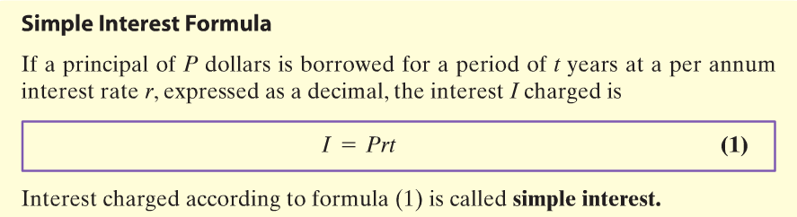
Copyright © 2012 Pearson Education, Inc. Publishing as Prentice Hall.

Slide 4
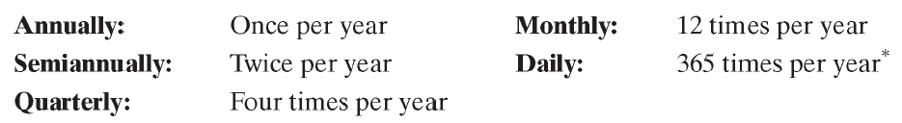
Copyright © 2012 Pearson Education, Inc. Publishing as Prentice Hall.

Slide 5

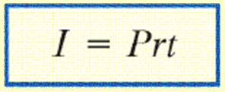
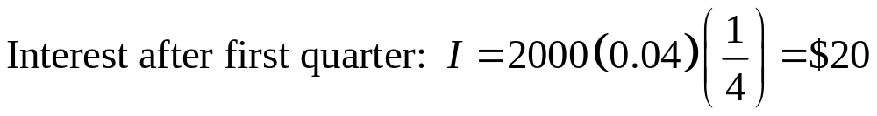
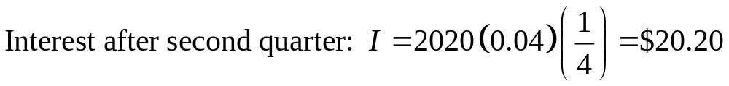
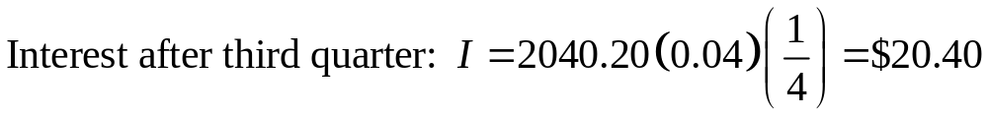
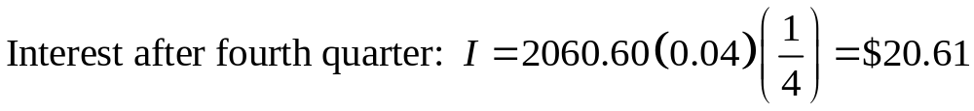
A credit union pays interest of 4% per annum compounded quarterly on a certain savings plan. If $2000 is deposited in such a plan and the interest is left to accumulate, how much is in the account after 1 year?
Copyright © 2012 Pearson Education, Inc. Publishing as Prentice Hall.

Slide 6

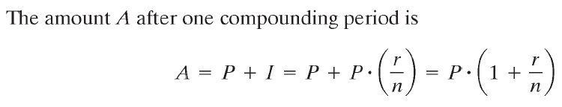
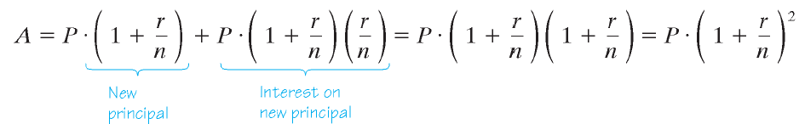
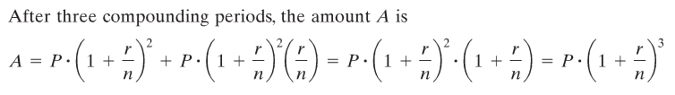

Copyright © 2012 Pearson Education, Inc. Publishing as Prentice Hall.

Slide 7
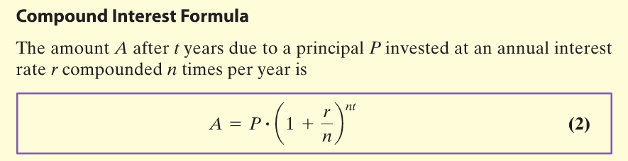
Copyright © 2012 Pearson Education, Inc. Publishing as Prentice Hall.

Slide 8

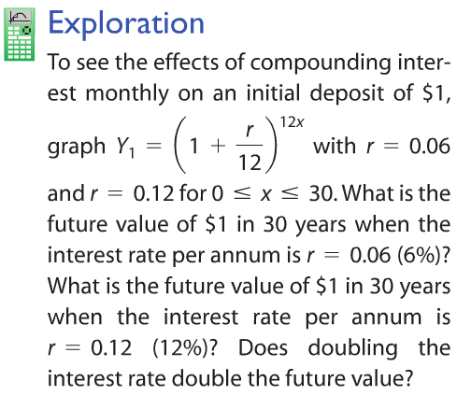

Copyright © 2012 Pearson Education, Inc. Publishing as Prentice Hall.

Slide 9
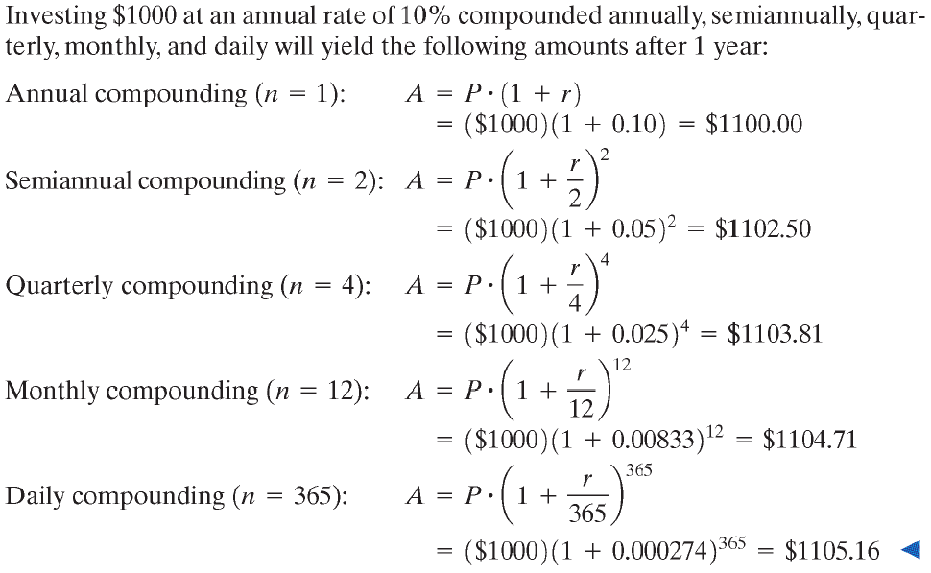
Copyright © 2012 Pearson Education, Inc. Publishing as Prentice Hall.

Slide 10
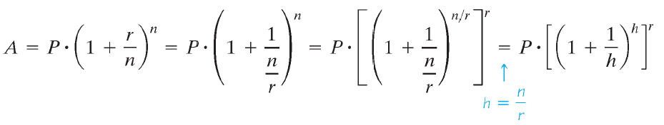
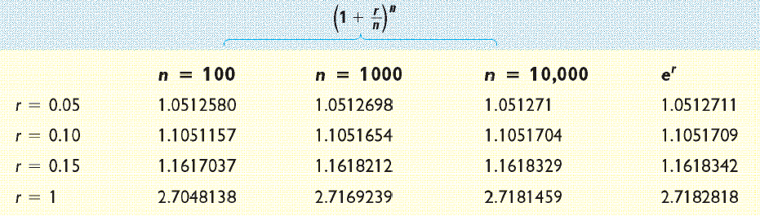
Copyright © 2012 Pearson Education, Inc. Publishing as Prentice Hall.

Slide 11
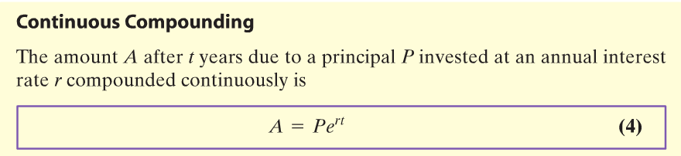
Copyright © 2012 Pearson Education, Inc. Publishing as Prentice Hall.

Slide 12
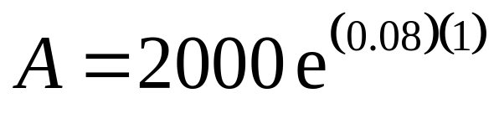
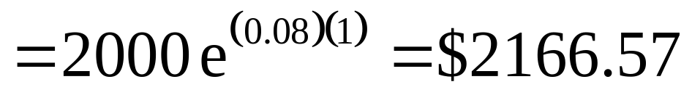
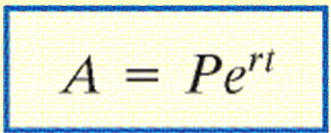
Find the amount A that results from investing a principal P of $2000 at an annual rate r of 8% compounded continuously for a time t of 1 year.
Copyright © 2012 Pearson Education, Inc. Publishing as Prentice Hall.

Slide 13
Copyright © 2012 Pearson Education, Inc. Publishing as Prentice Hall.

Slide 14
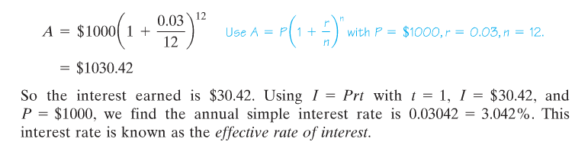
Suppose that you have $1000 and a bank offers to pay you 3% annual interest on a savings account with interest compounded monthly. In one year:
The effective rate of interest is the equivalent annual simple rate of interest that would yield the same amount as compounding after 1 year.
Copyright © 2012 Pearson Education, Inc. Publishing as Prentice Hall.

Slide 15
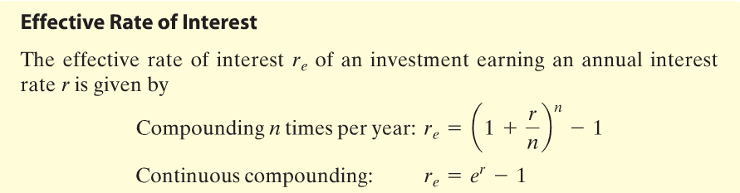
Copyright © 2012 Pearson Education, Inc. Publishing as Prentice Hall.

Slide 16


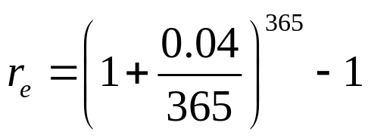
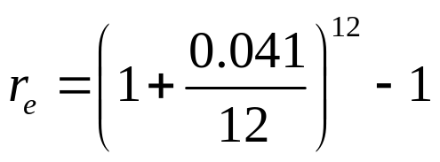







Suppose you want to open a money market account. You visit three banks to determine their money market rates. Bank A offers you 4% annual interest compounded daily, Bank B offers you 4.1% compounded monthly, and Bank C offers 3.95% compounded continuously. Determine which bank is offering the best deal.
Bank A | Bank B | Bank C
Bank B is offering the best deal
Copyright © 2012 Pearson Education, Inc. Publishing as Prentice Hall.

Slide 17
Copyright © 2012 Pearson Education, Inc. Publishing as Prentice Hall.

Slide 18
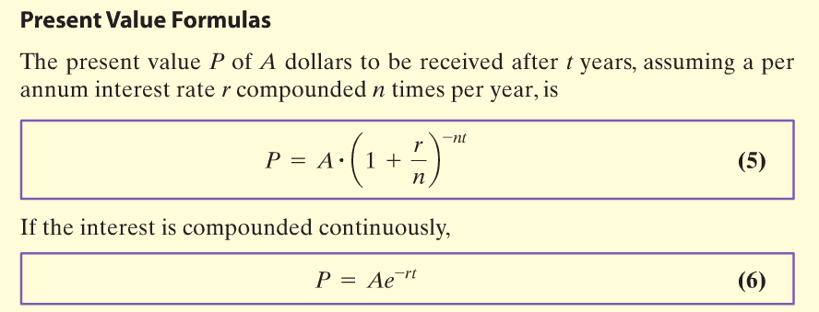
Copyright © 2012 Pearson Education, Inc. Publishing as Prentice Hall.

Slide 19
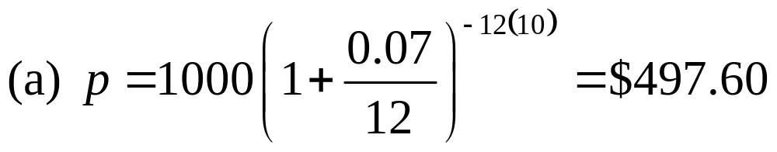
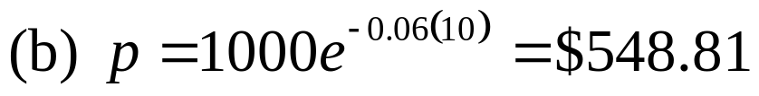
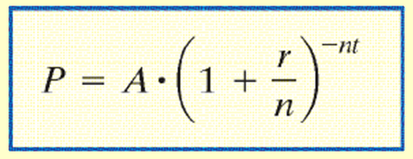
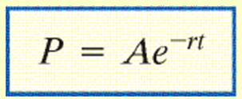
7% compounded monthly? (b) 6% compounded continuously?
Copyright © 2012 Pearson Education, Inc. Publishing as Prentice Hall.

Slide 20
Copyright © 2012 Pearson Education, Inc. Publishing as Prentice Hall.

Slide 21
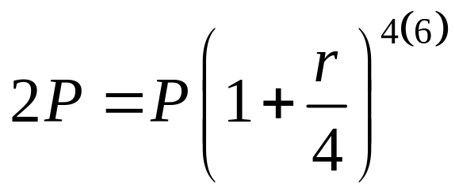
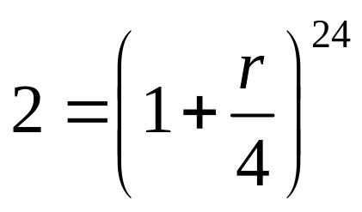
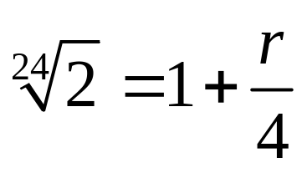
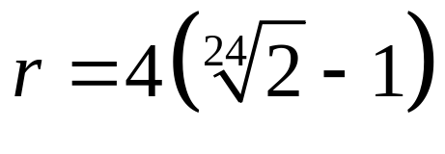

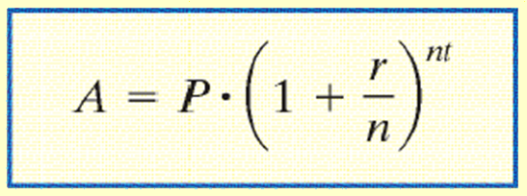
What annual rate of interest compounded quarterly should you seek if you want to double your investment in 6 years?
The annual rate of interest needed to double the principal in 6 years is 11.72%.
Copyright © 2012 Pearson Education, Inc. Publishing as Prentice Hall.

Slide 22
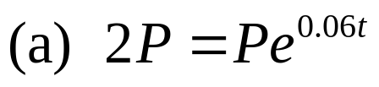







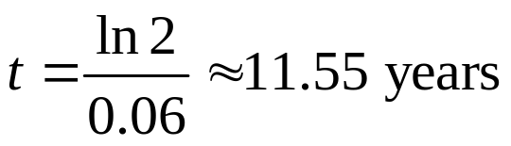
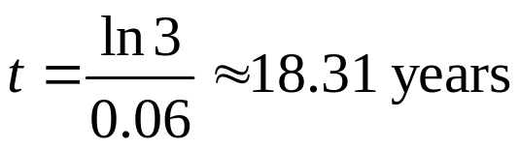
How long will it take for an investment to double in value if it earns 6% compounded continuously?
How long will it take to triple at this rate?
Copyright © 2012 Pearson Education, Inc. Publishing as Prentice Hall.

